Slide 1
EduMatrix
An Interactive Learning Platform for Programming Concepts

Slide 2
📘 Submitted By Group 1 :
Jenish Gohel (92300527156)
Yuvrajsinh Zala (92300527141)
Ravi Sav (92300527257)
📍 Internal Guide:
Prof. Dipak Thanki Faculty of Computer Applications,
🏫 Institution Address:
Marwadi University, Rajkot-Morbi Road, At & PO: Gauridad, Rajkot

Slide 3
EduMatrix is a Comprehensive Interactive Desktop Application for Learning and Practicing Core Programming Concepts Through Quizzes, Games, and Code Reference Tools“.
Introduction :
The project primarily targets students and self-learners who wish to strengthen their understanding of core programming subjects, including Python, Java, C, Web Technologies, and Operating Systems.

Slide 4
Objective : To create an interactive desktop application that enhances programming learning through quizzes, games, and learning tools.
Technologies Used : Python, Tkinter, SQLite
Target Audience :
BCA/BTech/IT students
Beginners in programming
Learners preparing for technical interviews and coding rounds

Slide 5
Key Features :
Modular Interface: Each component (Quiz, Game, learning tools, Dashboard) is independently designed for scalability.
Instant Feedback System: Users receive detailed answer justifications in real-time for quiz.
Multi-Subject Support: Covers Python, Java, C, Web Technologies, and Operating Systems.
Data Protection: Fully offline functionality with secure local data storage via SQLite
Gamification: Uses psychology-backed strategies (like challenge, feedback) to enhance engagement..

Slide 6
Supported Subjects :
EduMatrix includes core programming disciplines to provide a holistic coding foundation:
Python: Basic to intermediate concepts with syntax support
Java: OOP principles, control structures, exception handling
C Programming: Procedural logic, memory handling, and control flow
Web Technologies: CSS, JavaScript, HTML basics
Operating Systems: File systems, processes, memory, and scheduling

Slide 7
Modules in EduMatrix :
Each module can be accessed independently through the main menu.
Quiz Module: Structured quizzes with time-bound logic, scoring, and answer review.
Game Center: Interactive games designed to reinforce learning through fun.
Dashboard: Visual representation of scores, attempts, and trends.
Language Tool: Built-in study guide for syntax, errors, keywords, and reusable code.

Slide 8
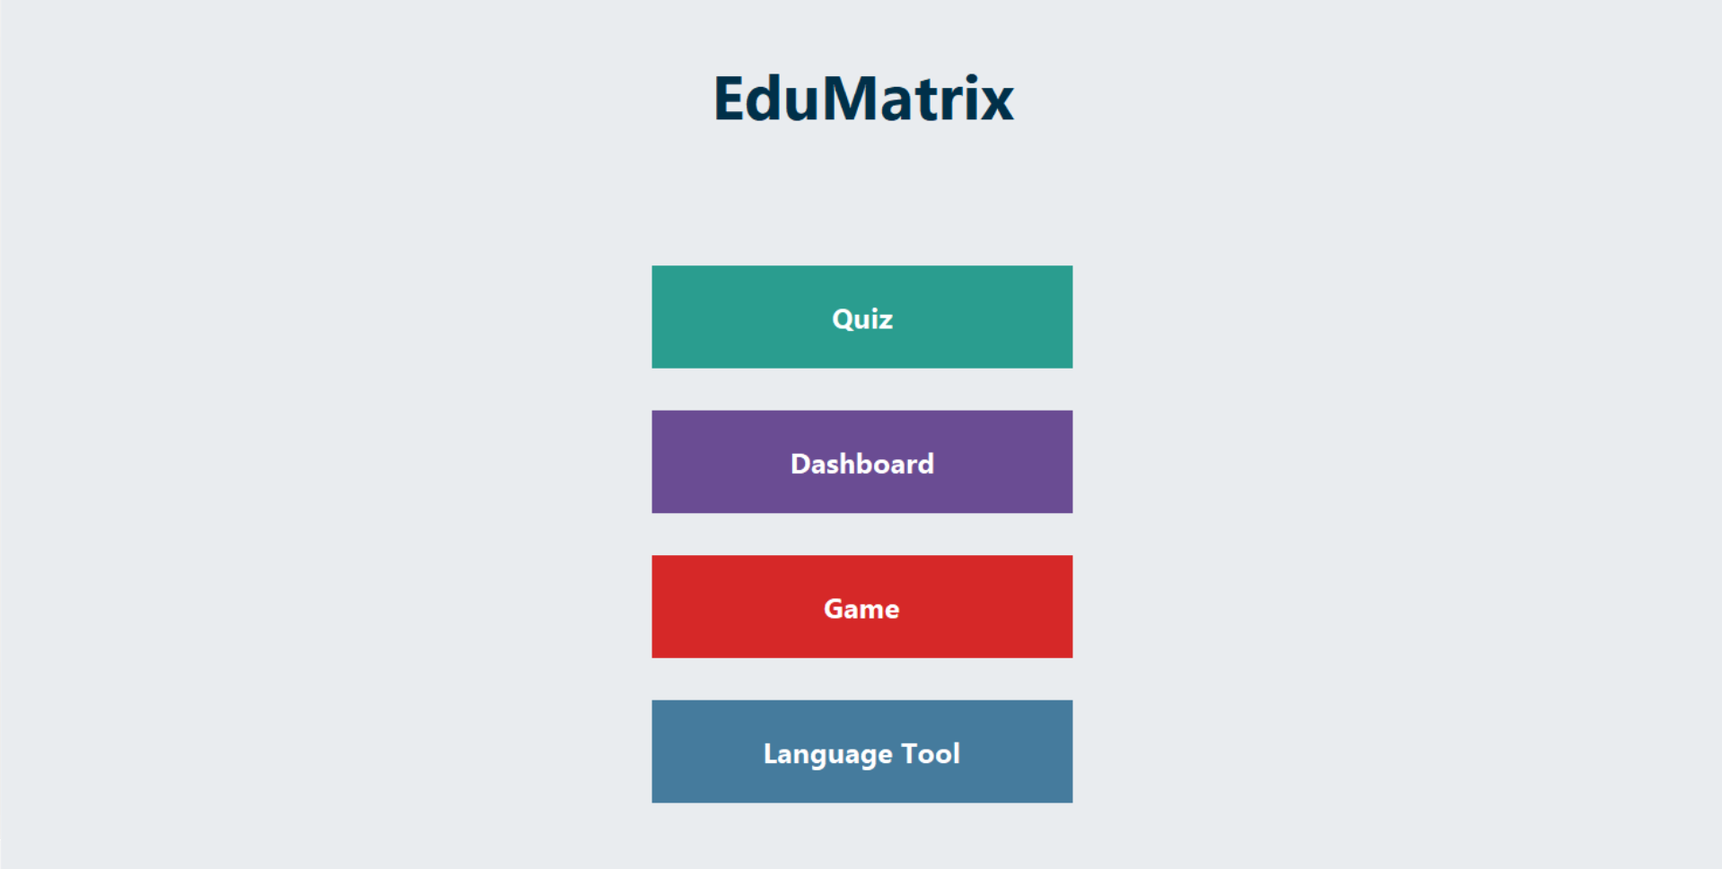
The Home Page of EduMatrix serves as the central navigation hub from which users can access all the main features of the application. Designed using Python's Tkinter GUI framework, it offers a user-friendly and visually engaging interface.o ensure smooth access to different educational modules.

Slide 9
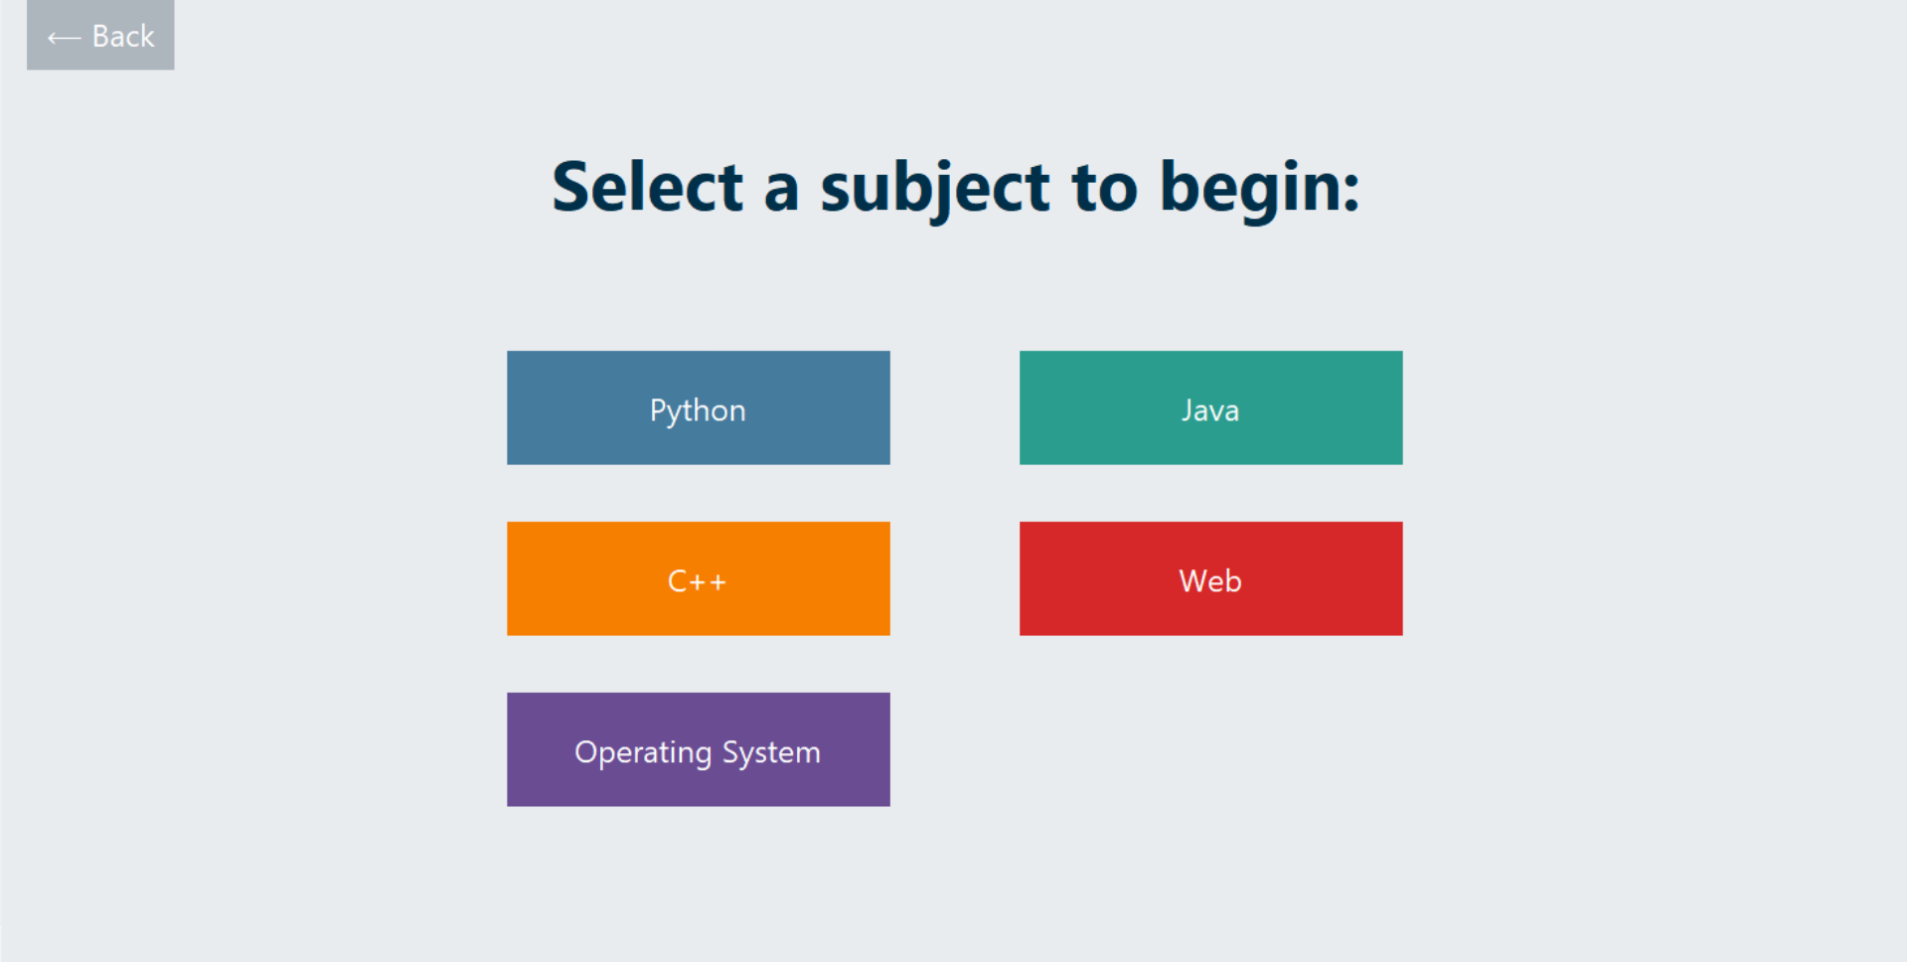
1. Quiz Module :
Select a subject, start the quiz, and answer MCQs.
Each quiz is randomized with immediate correctness feedback.
Users can revisit and revise answers before final submission.
Summary screen displays score, time taken, and correct answers.
Attempts are stored for progress monitoring.

Slide 10
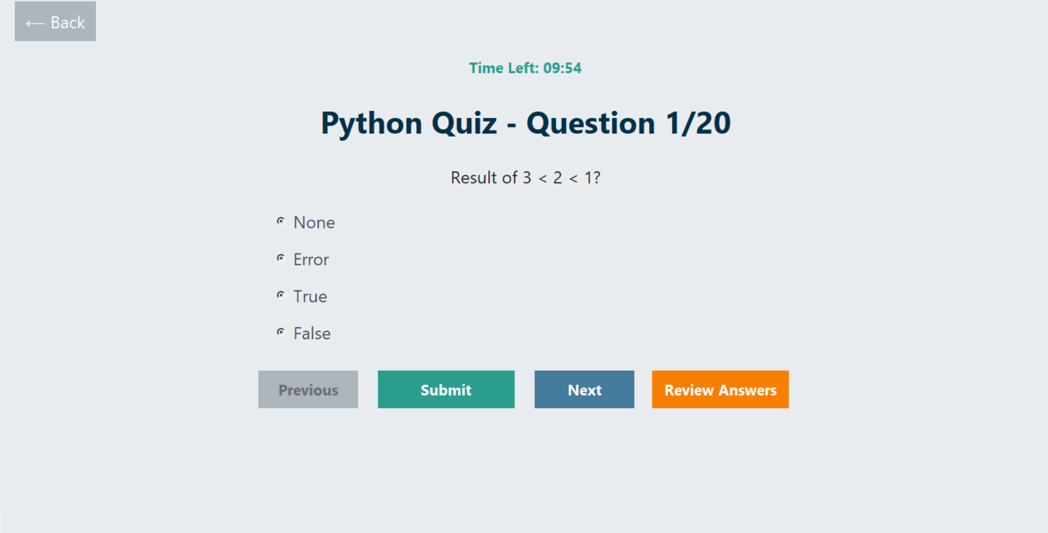
Quiz Benefits:
Reinforces learning
Tracks improvement
Identifies weak area

Slide 11
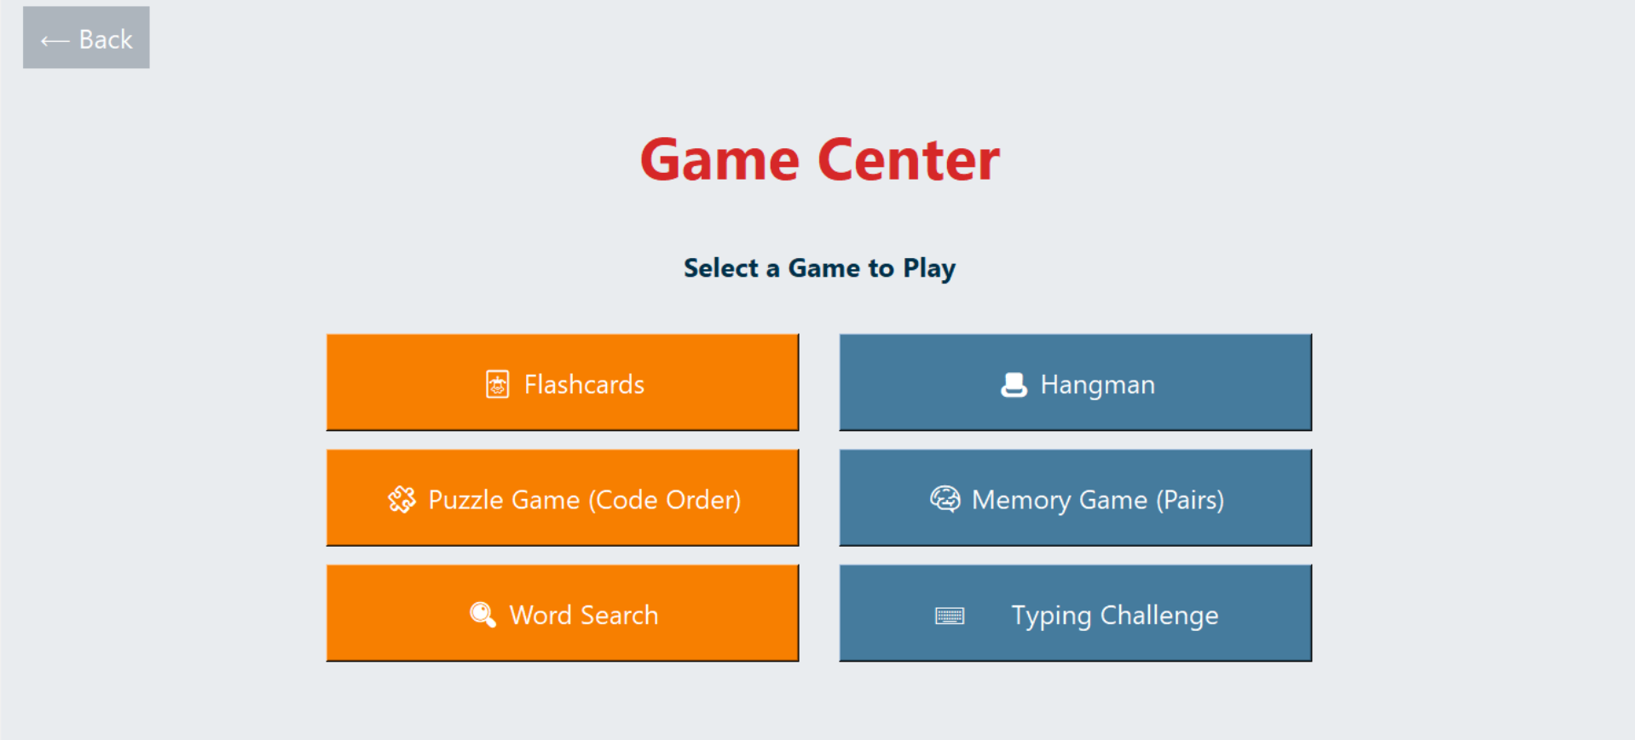
2. Game Center :
Purpose: Make learning enjoyable & interactive.
The Game Center module is designed to make learning programming fun, engaging, and interactive by integrating educational content into various games. Its primary purpose is to reinforce programming concepts through gamified learning experiences, helping users retain knowledge more effectively.

Slide 12
Games Included:
Flashcards: Memorize definitions and code snippets.
Hangman: Guess keywords from programming languages.
Puzzle Game: Drag-and-drop logic structure.
Memory Game: Match pairs of questions and answers.
Word Search: Find hidden coding terms.
Typing Challenge: Improve typing speed and recall.

Slide 13
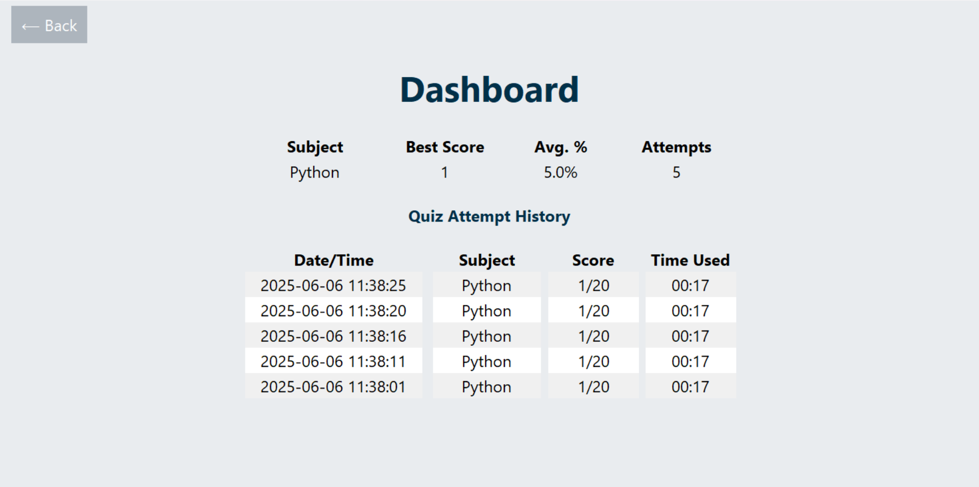
3. Dashboard
Shows performance by subject and quiz attempt.
Visual indicators show progress over time.
Tracks high scores and averages for self-assessment.
Easily navigate to review past attempts.

Slide 14
Why it matters :
Motivates users to improve
Highlights strong and weak subjects
Encourages consistent practice
Displayed Information Includes :
Subject of each quiz attempt
Score achieved
Date and time taken
Duration of quiz
Number of attempts per subject
Highest and average scores

Slide 15
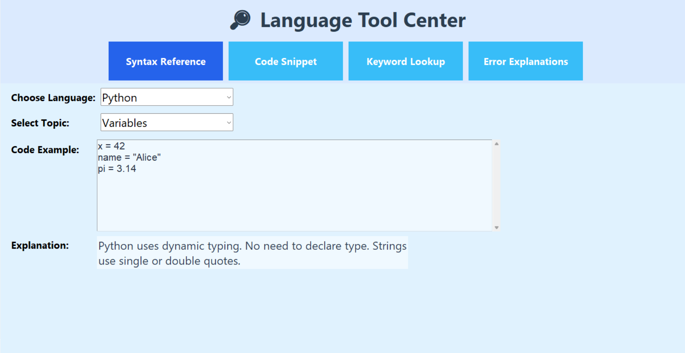
4. Language Tool :
Syntax References: Covers common constructs and examples.

Slide 16
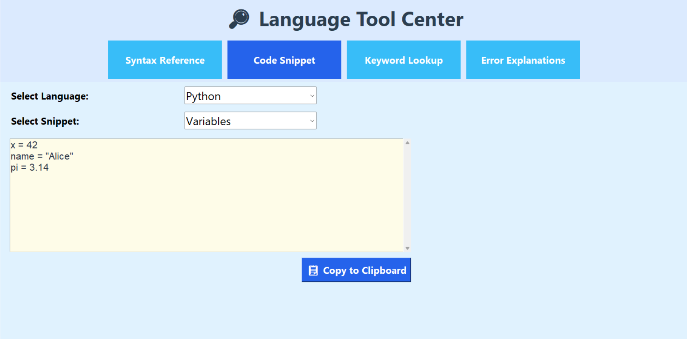
Code Snippets: Copy-ready blocks for practice or assignments.

Slide 17
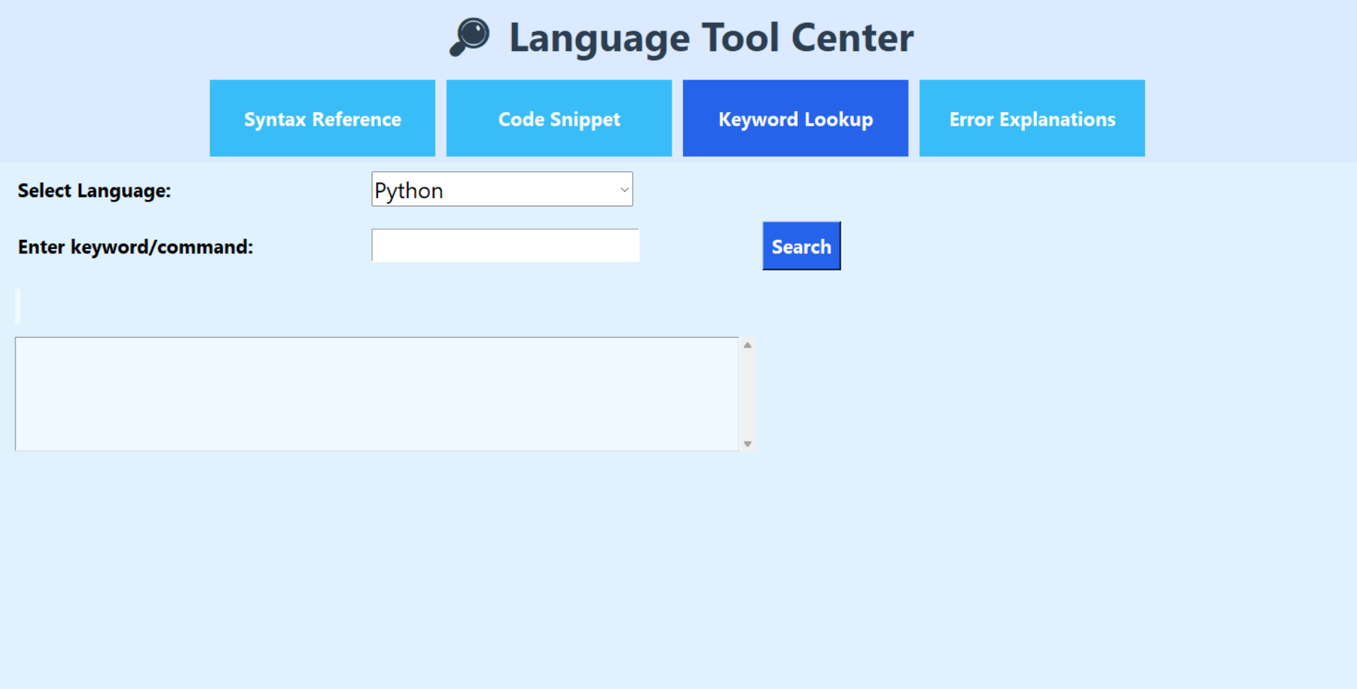
Keyword Lookup: Quickly understand definitions and usage.

Slide 18
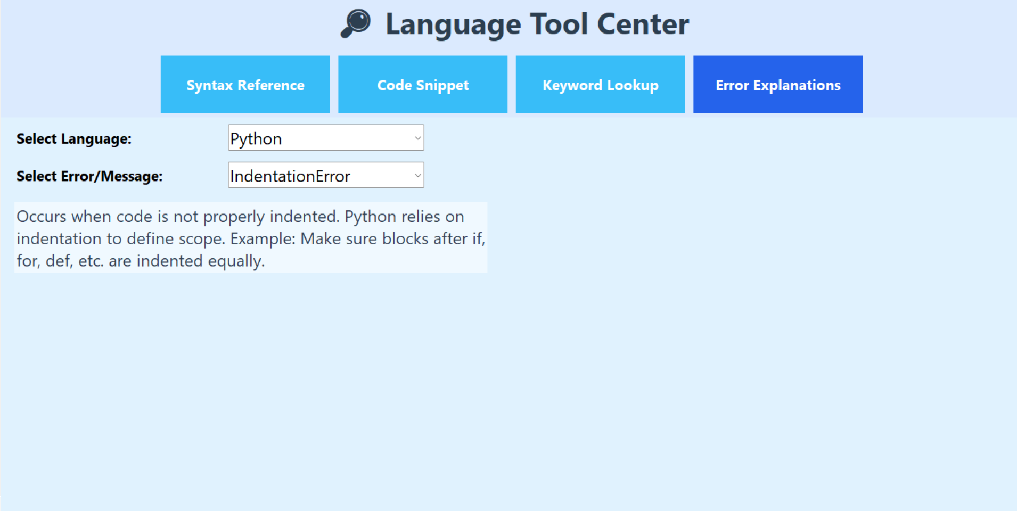
Error Explanations: Meaningful messages with solutions.

Slide 19
Technical Requirements :
Hardware:
2GB RAM (4GB recommended)
200MB disk space
1024×768 display resolution
Mouse/Keyboard input
Software:
OS: Windows, Linux, or macOS
Python 3.7+
Tkinter (bundled with Python)
SQLite3 (bundled with Python)

Slide 20
System Design Diagrams :
Included Diagrams in documentation:
Flowchart: Logical control flow of app
Activity Diagram: Sequence of actions across modules
Use Case Diagram: Actor-module relationships
Database Design: Table design and data flow

Slide 21
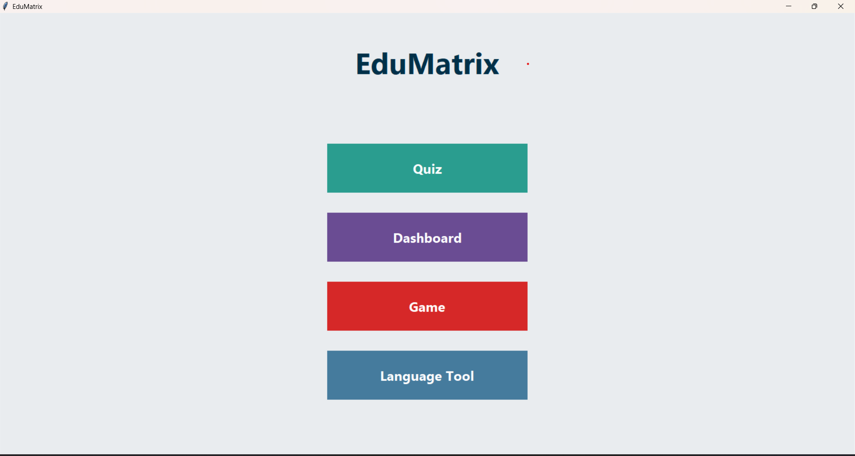
GUI Overview :
Main Menu: Clean layout with easy access to all modules

Slide 22
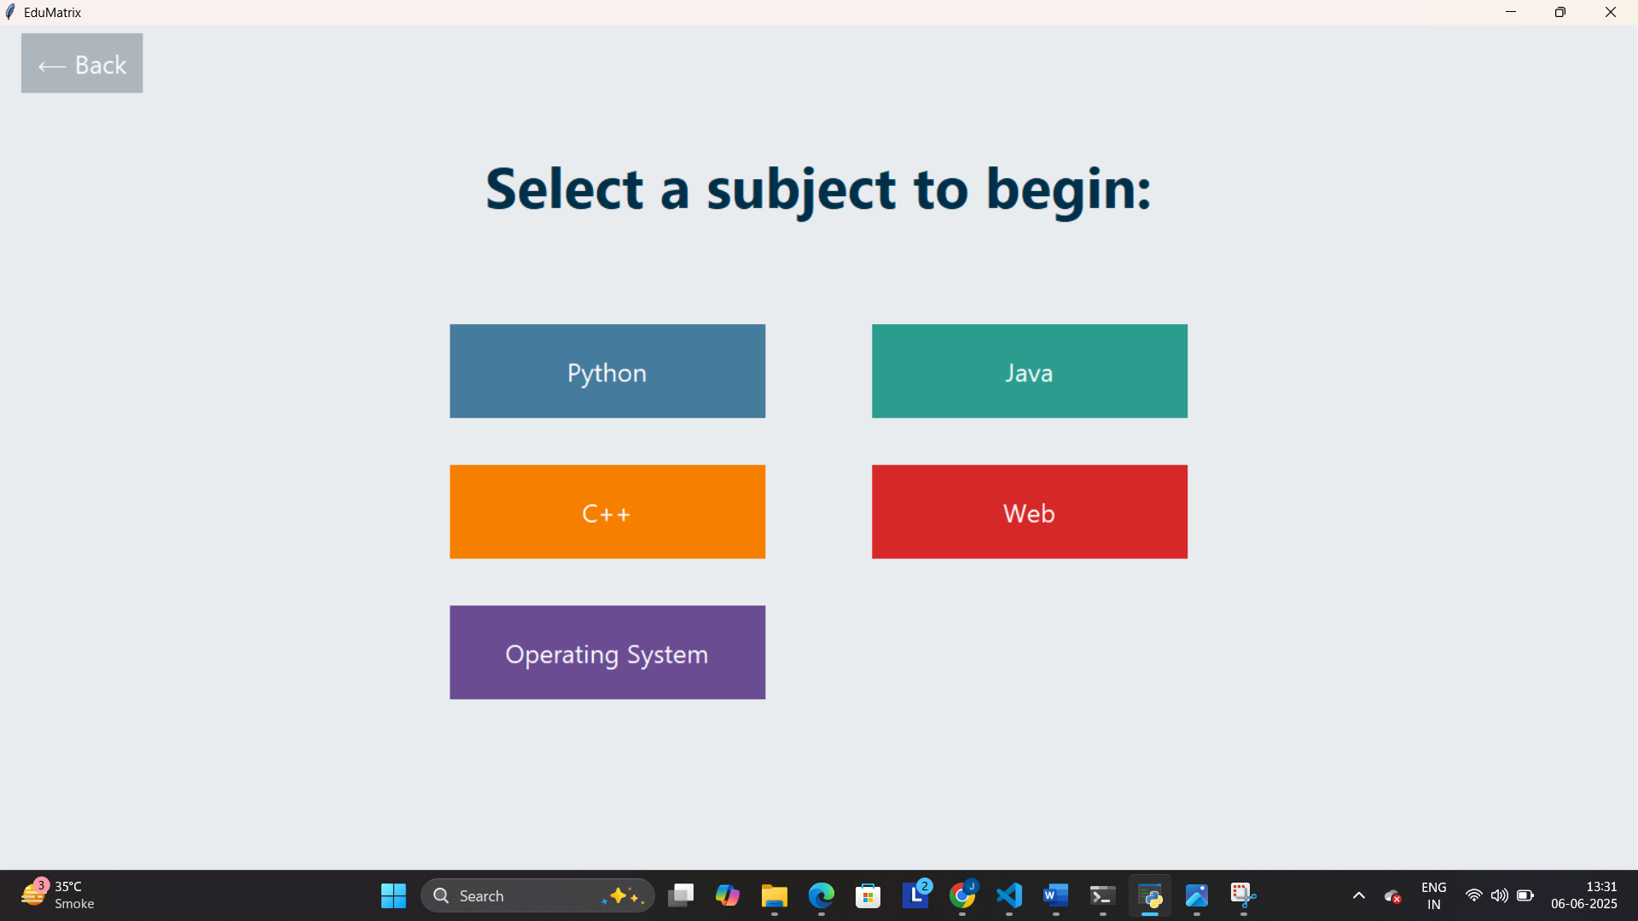
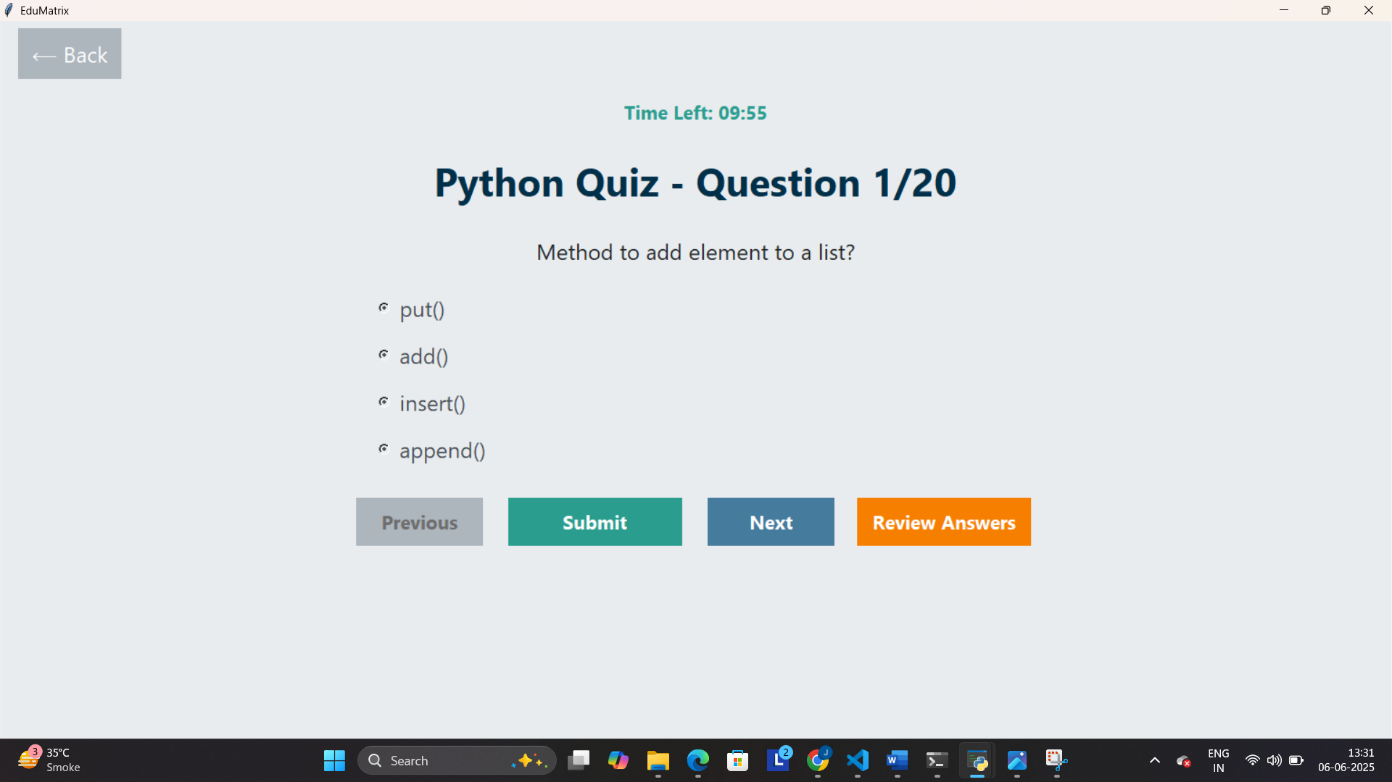
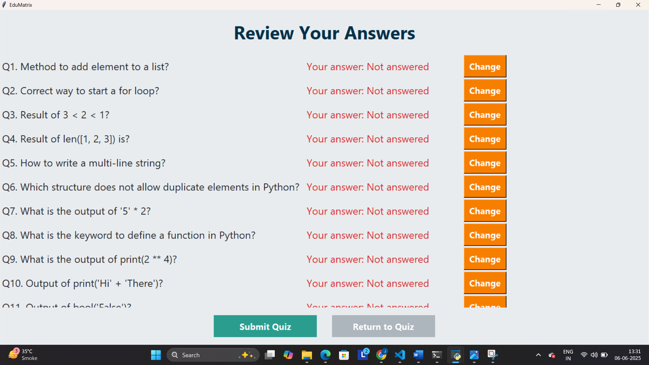
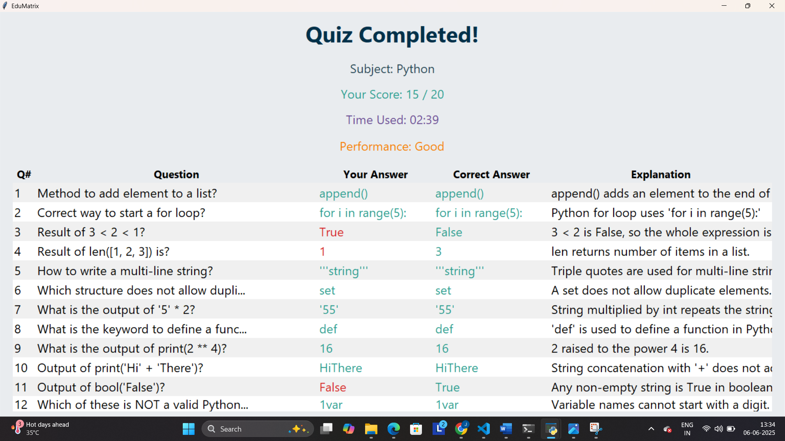
Quiz Section: Subject selection, timed quizzes, instant results

Slide 23
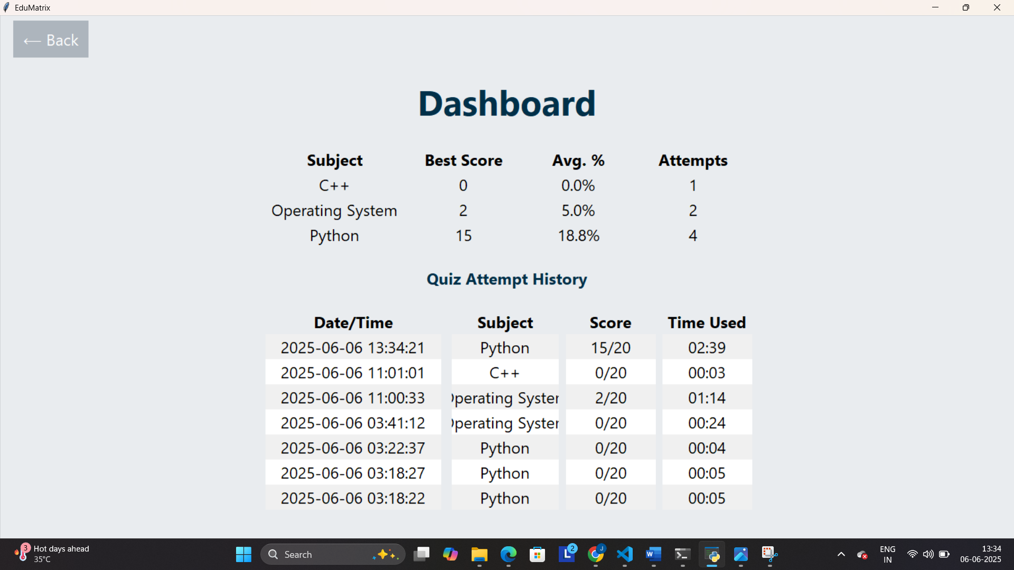
Dashboard: shows performance by subject and quiz attempt.

Slide 24
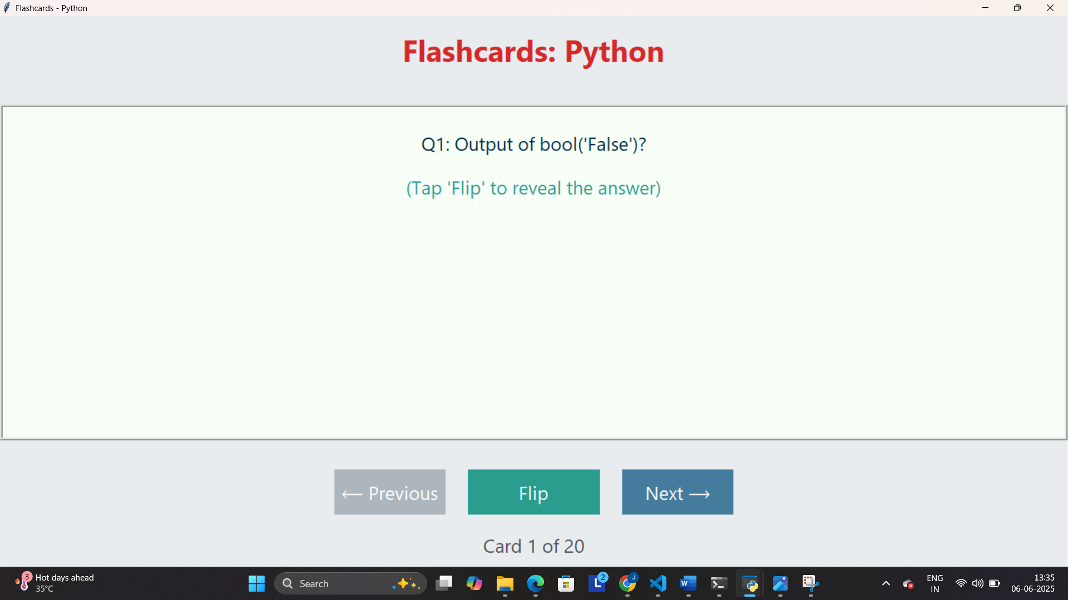
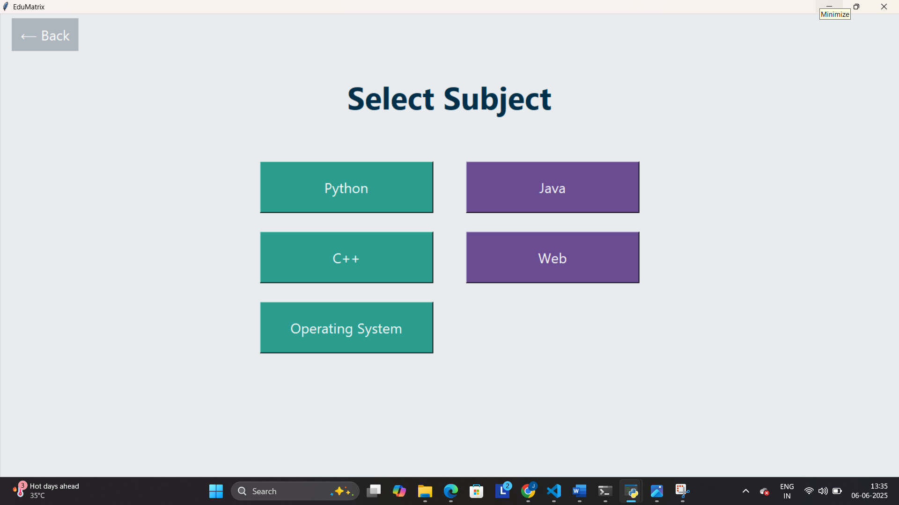
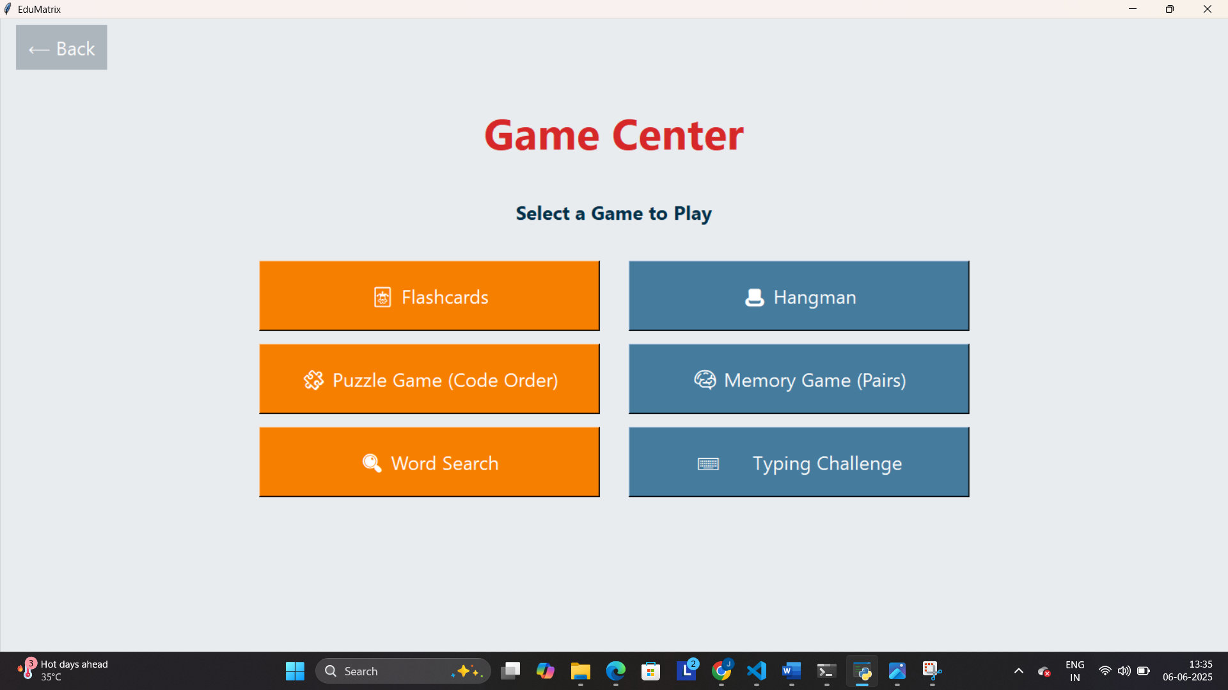
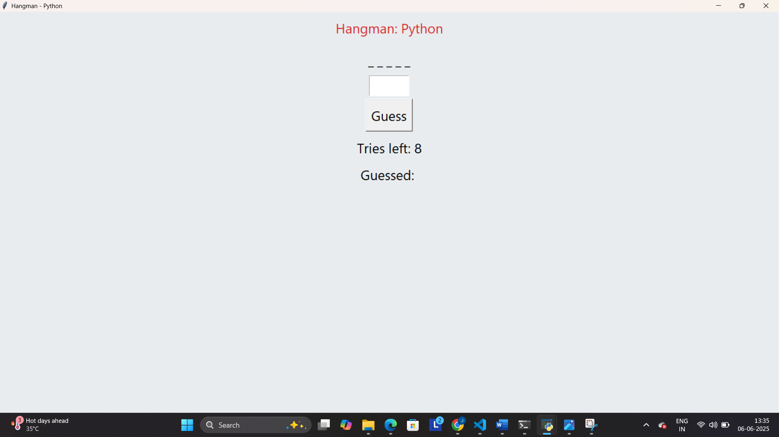
Games: Flashcards, Hangman, Puzzle, Typing, etc.

Slide 25
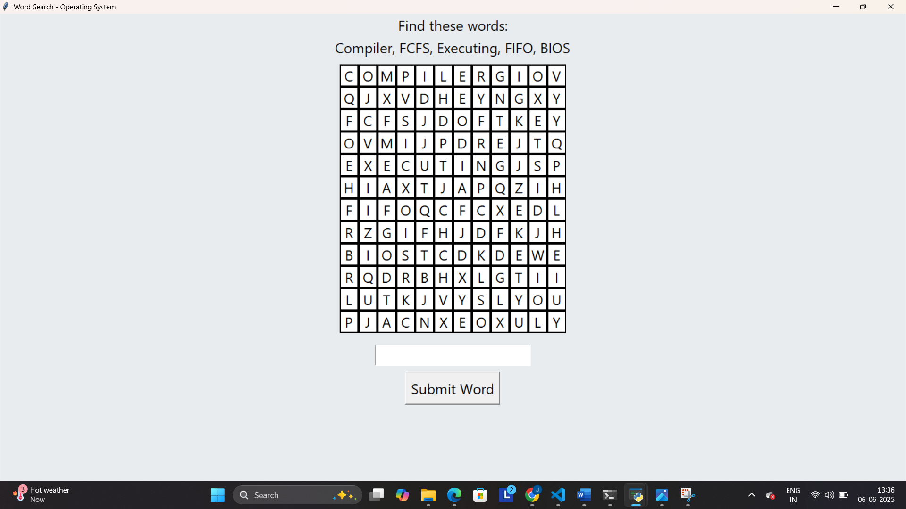
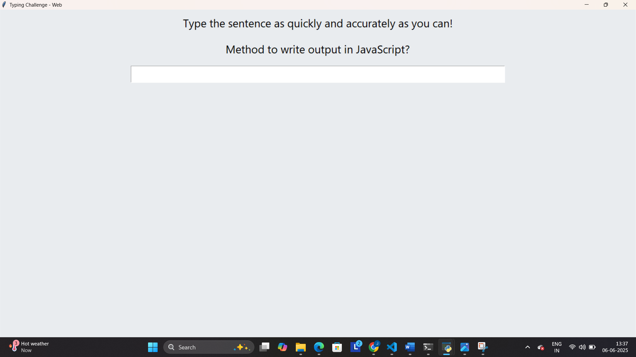
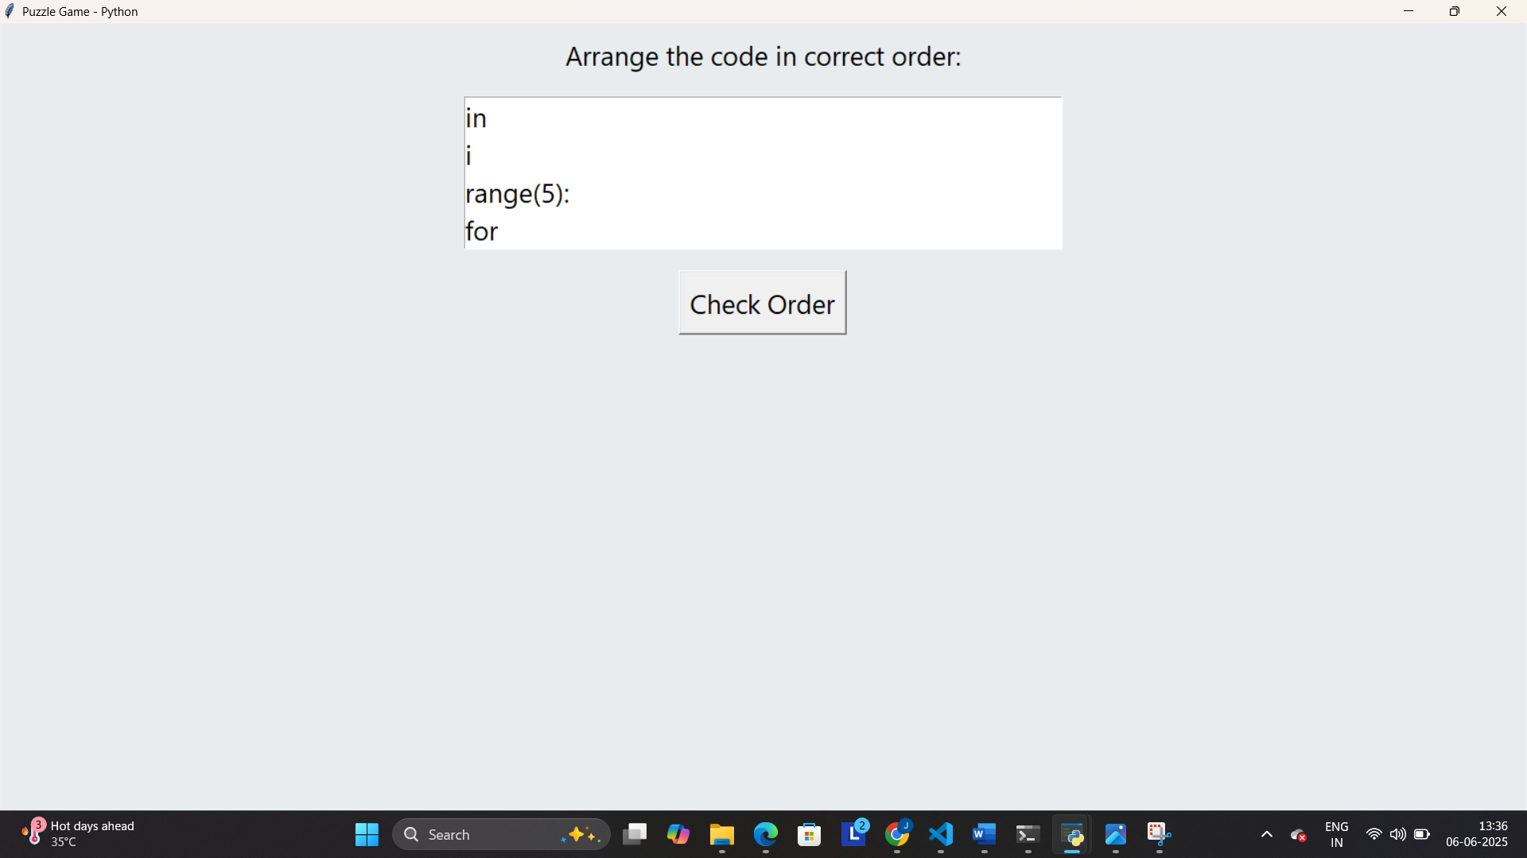
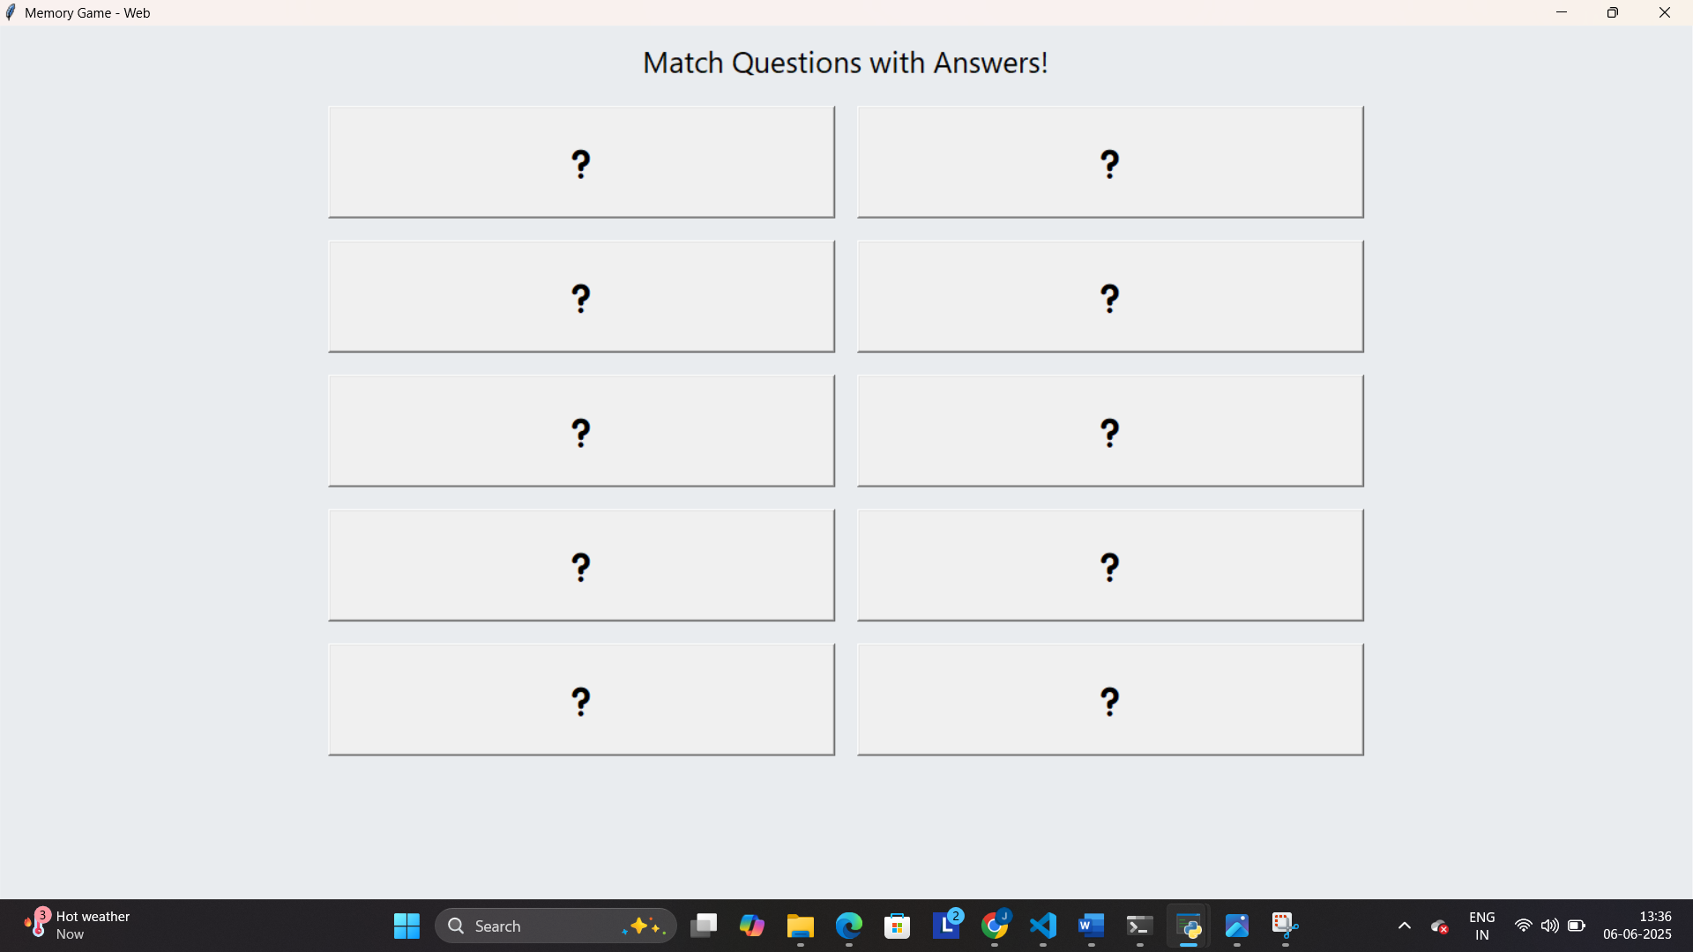

Slide 26
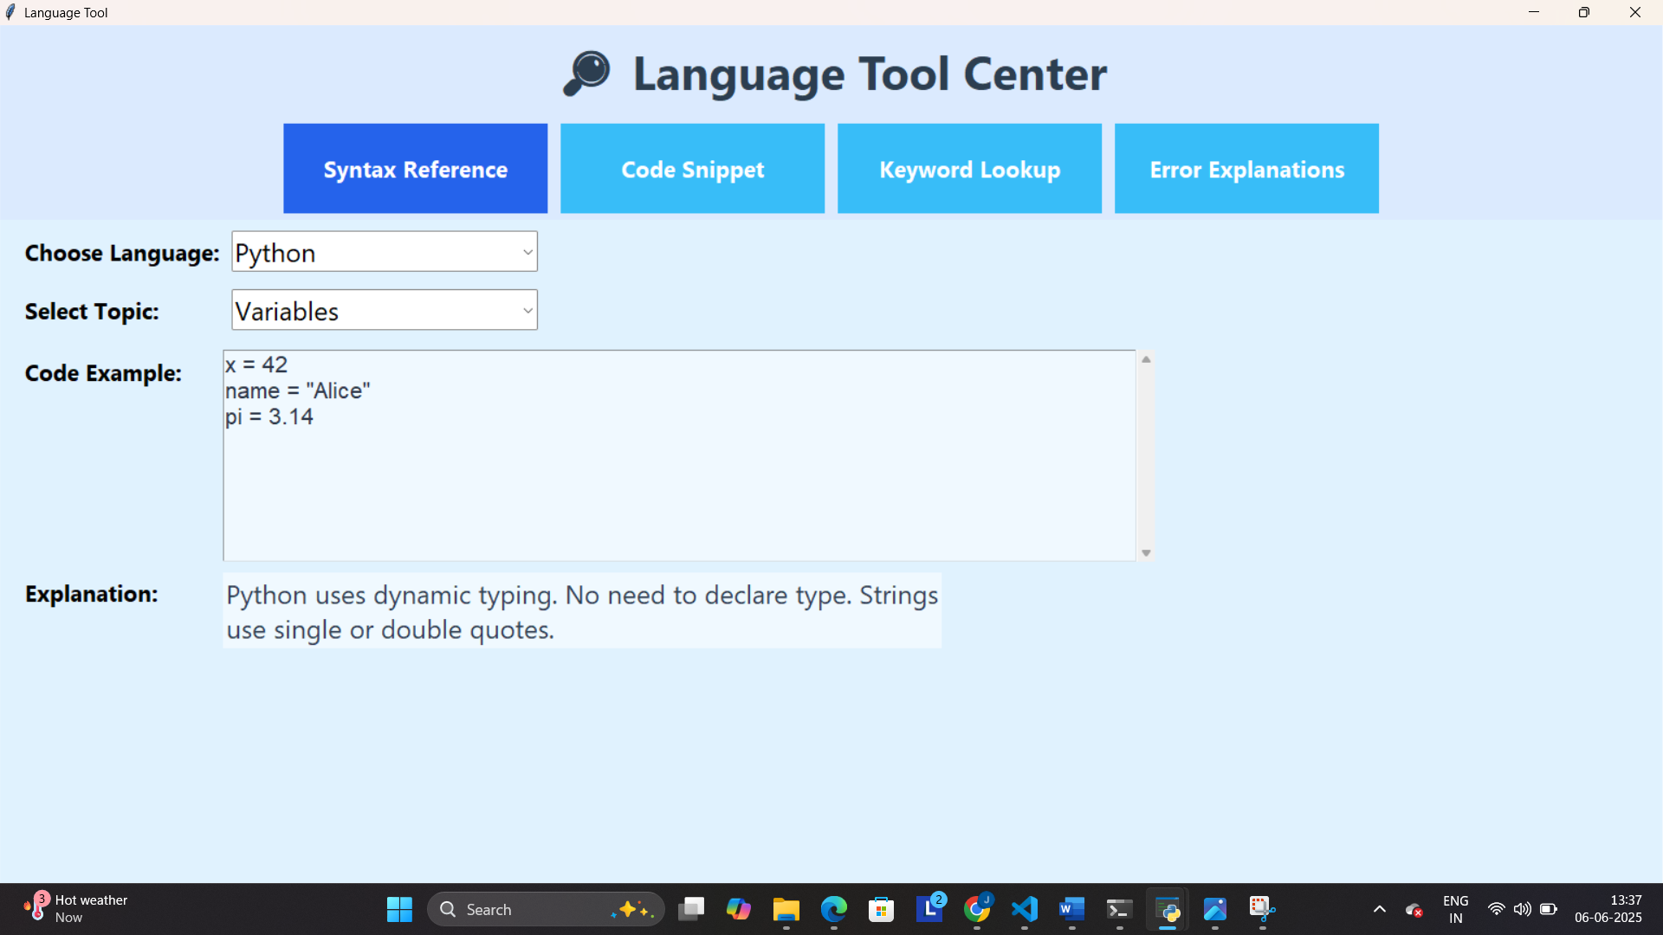
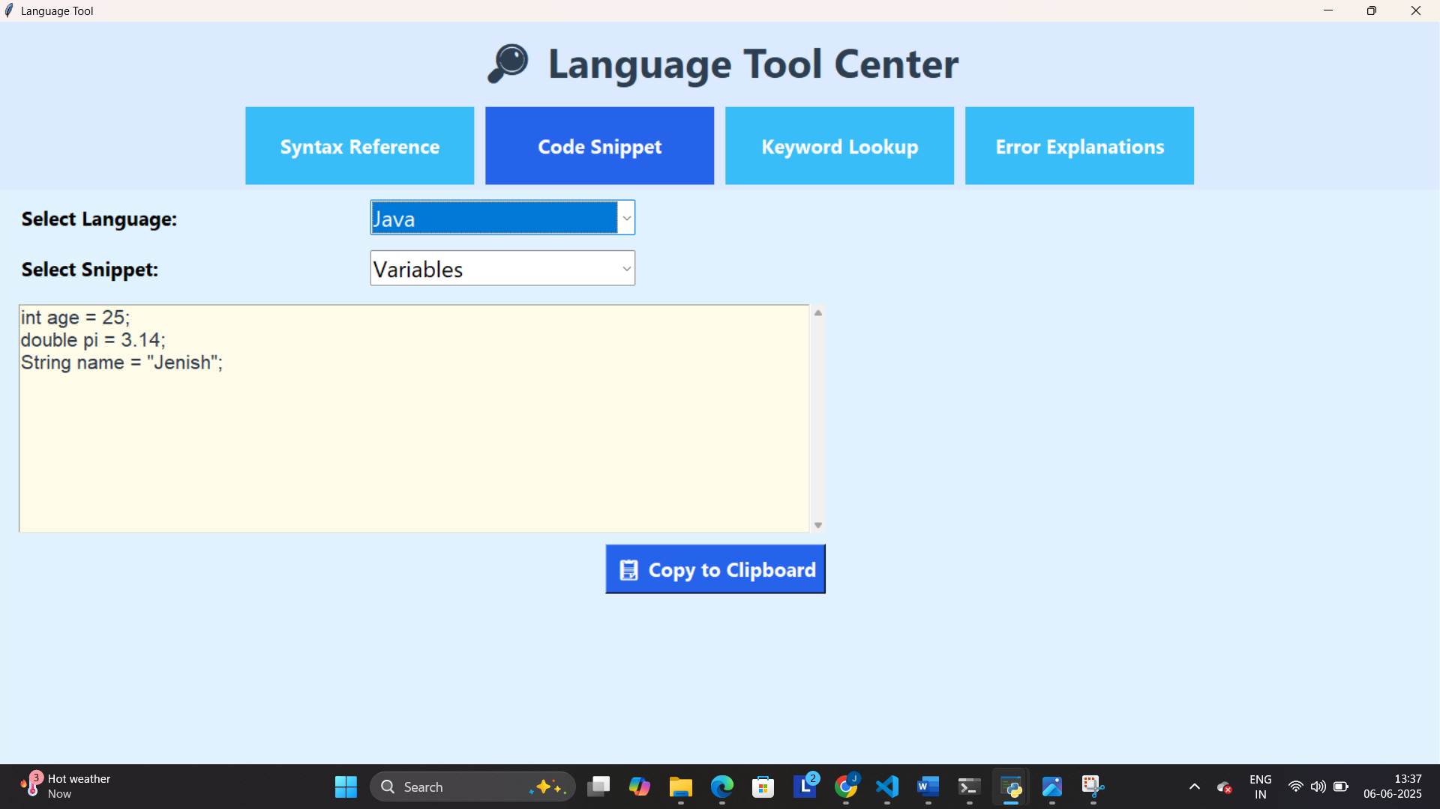
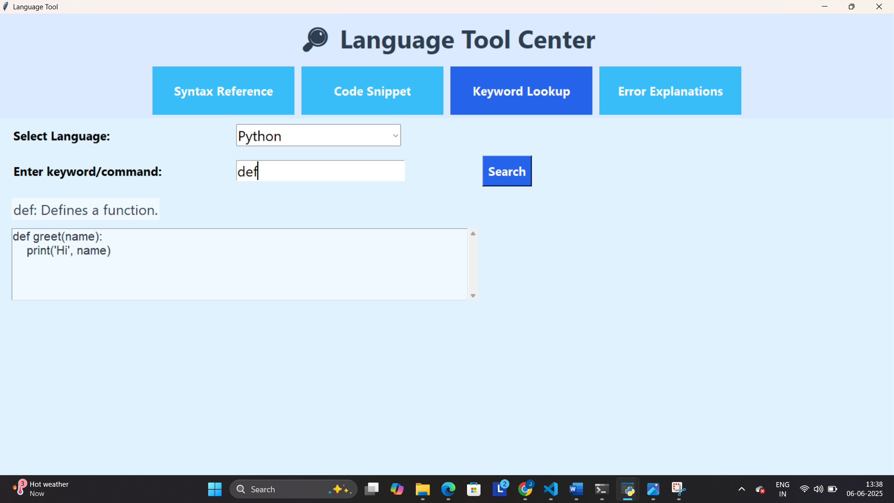
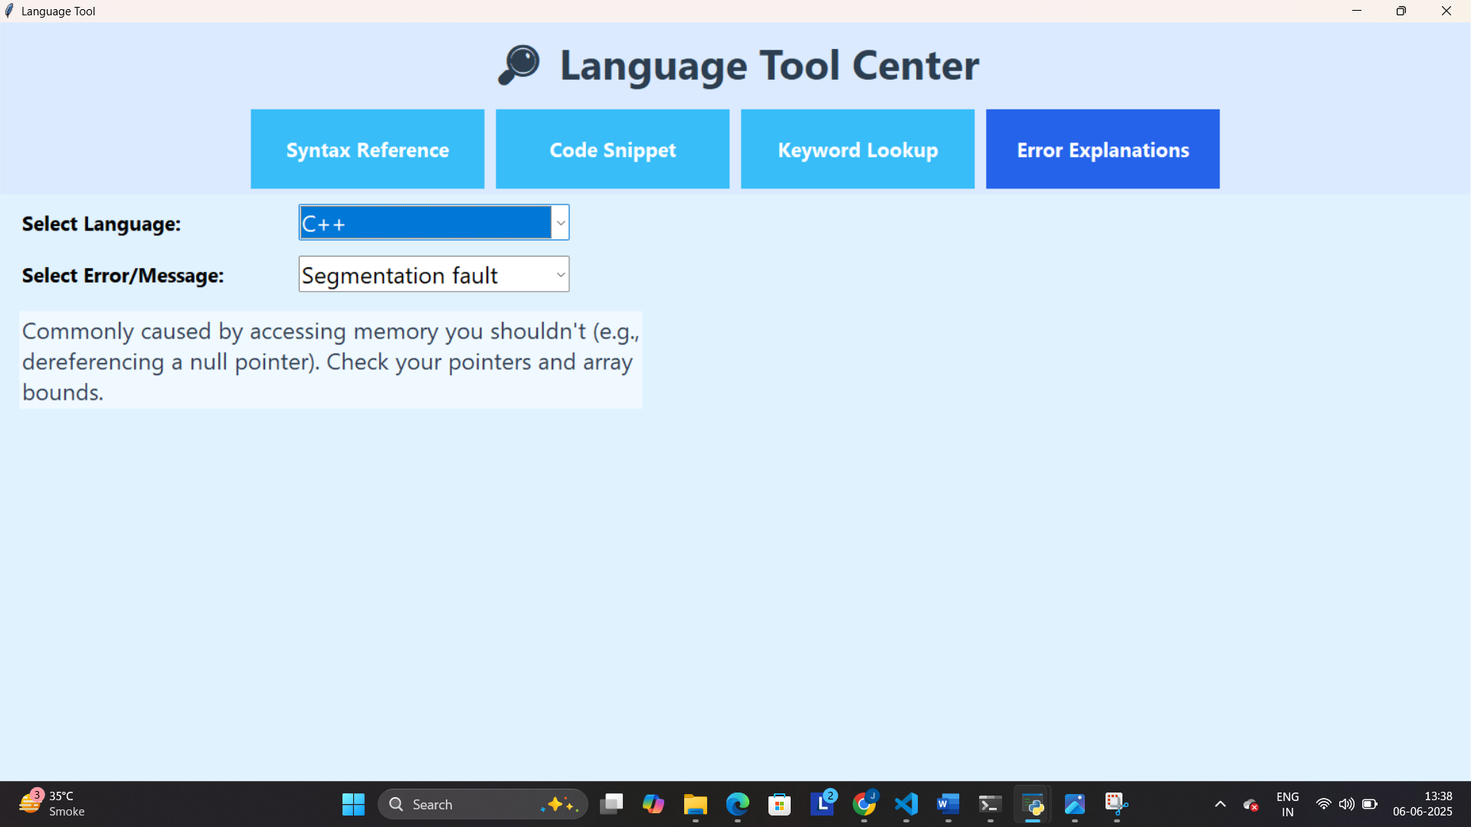
Language Tool : Quick access to syntax , code snippets Keyword and error help

Slide 27
Learning During SIP :
Key Skills Acquired:
GUI Development
Database Handling
Modular Programming:
Design
Debugging
Gamification Logic
Documentation & Git
Multi-threaded Thinking

Slide 28
Bibliography :
1. Online References:
Python Docs: docs.python.org
SQLite Docs: sqlite.org
GeeksforGeeks, StackOverflow, TutorialsPoint
2. Offline References:
Programming in Python – E. Balagurusamy
Let Us C – Yashavant Kanetkar
Java: The Complete Reference – Herbert Schildt
Python Programming – John Zelle

Slide 29
Conclusion :
EduMatrix is a complete educational ecosystem that merges learning, practice, and fun into one offline-friendly application.
By combining quizzes, games, and reference tools, the application enhances concept retention and user engagement.
Key Outcomes:
Simplifies complex programming topics
Engages users via gamification
Supports personalized learning journeys
Promotes independence in learning

Slide 30


